Slide 1


Mobile Learning Application Development
Presented By:
Rakib Hossen
Assistant Professor
Dept. of Cyber Security Engineering (CySE), UFTB

Slide 2





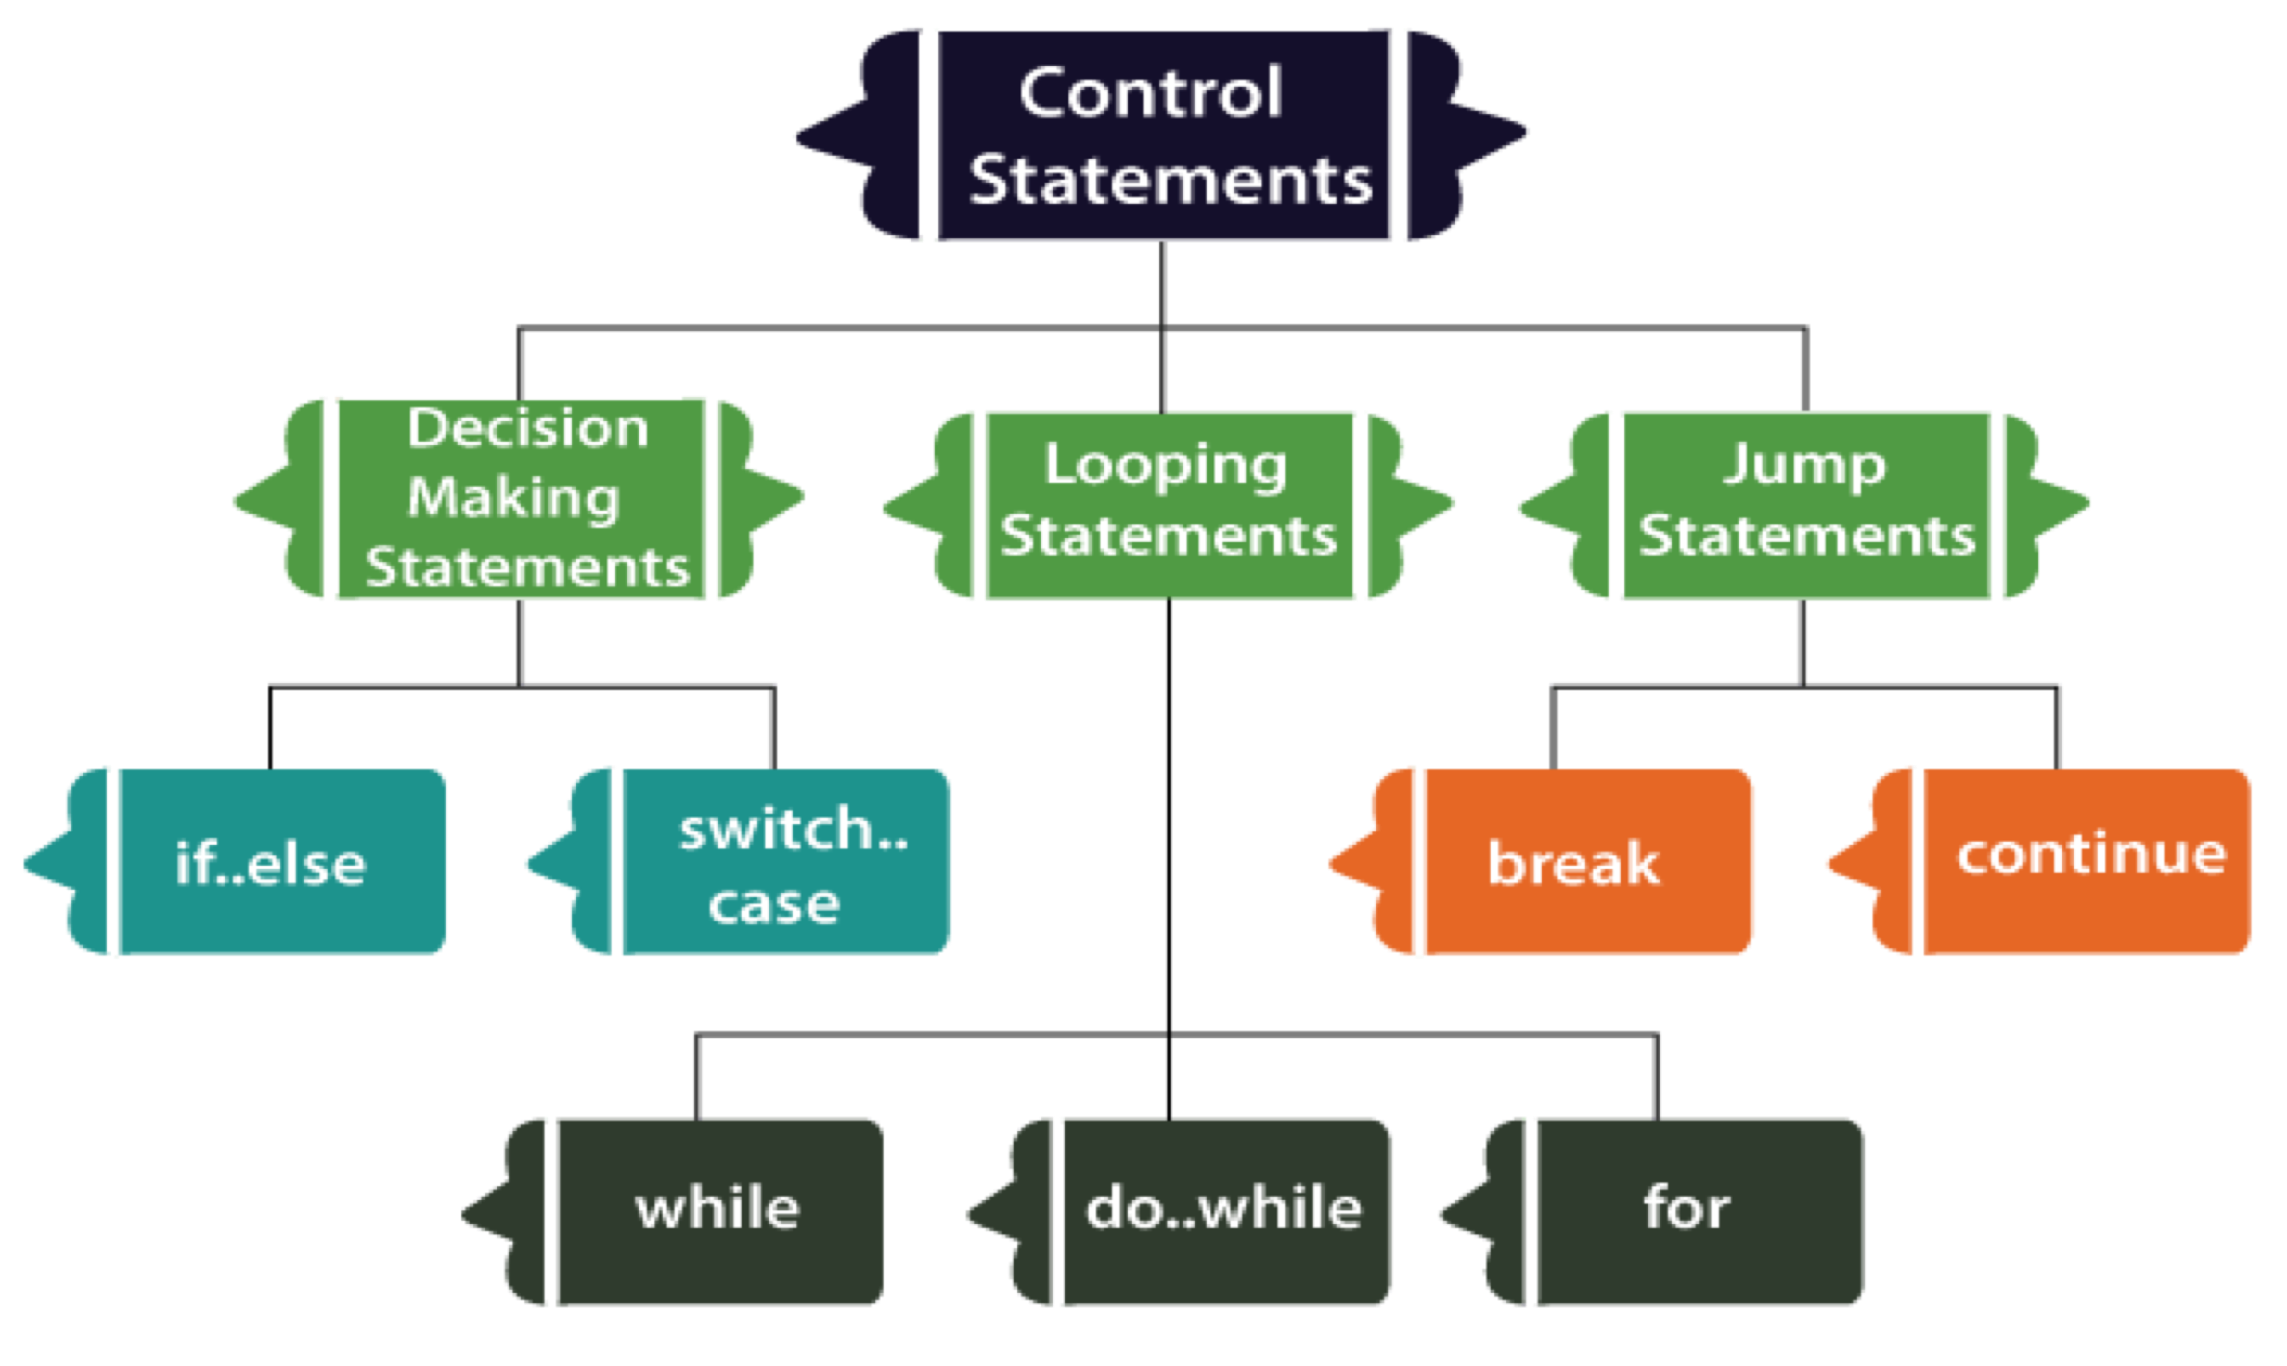
Dart Control Flow Statement
The control statements or flow of control statements are used to control the flow of Dart program. In Dart, Control flow statement can be categorized mainly in three following ways.
Decision-making statements
Looping statements
Jump statements

Slide 3

Dart Decision-Making Statements
The Decision-making statements allow us to determine which statement to execute based on the test expression at runtime. Dart provides following types of Decision- making statement.
If Statement
If-else Statements
If else if Statement
Switch Case Statement

Slide 4

If Statement
If statement allows us to a block of code execute when
condition returns true.
Syntax -
If (condition) {
//statement(s)
}
void main () { var n = 35; if (n<40){
print("The number is smaller than 4 0")
};
}
the given

Slide 5


else Statements
If-
In Dart, if-block is executed when the given condition is true. If the given condition is false, else-block is executed. The else block is associated with the if-block.
Syntax - if(condition) {
// statement(s);
} else {
// statement(s);
}
void main() { var x = 20; var y = 30;
print("if-else statement example"); if(x > y){
print("x is greater than y");
} else {
print("y is greater than x");
};
}

Slide 6

if else-if Statement
Dart if else-if statement provides the facility to check a set of test expressions and execute the different statements. It is used when we have to make a decision from more than two possibilities.
void main() { var marks = 74; if(marks > 85)
{
print("Excellent");
}
else if(marks>75)
{
print("Very Good");
}
else if(marks>65)
{
print("Good");
}
else
{
print("Average");
}
}
Syntax -
if (condition1) {
}
else if(condition2) {
} .
.
else {
}

Slide 7

Switch Case Statement
Dart Switch case statement is used to avoid the long chain of the if-else statement. It is the simplified form of nested if-else statement. The value of the variable compares with the multiple cases, and if a match is found, then it executes a block of statement associated with that particular case.
Syntax - switch( expression )
{
case value-1:{
Block-1; break;
case value-N:{ Block-N; break;
void main() {
int n = 2; switch (n) {
case 1:
print("Value is 1"); break;
case 2:
print("Value is 2"); break;
case 3:
print("Value is 3"); break;
default:
print("Out of range"); break;
}
}
default: {
}
}

Slide 8

Dart Looping statements
Dart Loop is used to run a block of code repetitively for a given number of times or until matches the specified condition. Loops are essential tools for any programming language. It is used to iterate the Dart iterable such as list, map, etc. and perform operations for multiple times. A loop can have two parts - a body of the loop and control statements. The main objective of the loop is to run the code multiple times. Dart supports the following type of loops.
Dart for loop
Dart for…in loop
Dart while loop
Dart do-while loop

Slide 9

Dart for loop
The for loop is used when we know how many times a block of code will execute. It is quite same as the C for loop. The syntax is given below.
for(Initialization; condition; incr/decr) {
// loop body
}
void main()
{
int num = 1;
for(num; num<=10; num++) { print(num);
}
}

Slide 10

Dart for… in Loop
The for…in loop is slightly different from the for loop. It only takes dart object or expression as an iterator and iterates the element one at a time. The value of the element is bound to var, which is and valid
void main()
{
var list1 = [10,20,30,40,50];
for(var i in list1) { print(i);
}
and available for the syntax is given below.
for (var in expression) {
//statement(s)
}
loop body. The
}

Slide 11

Dart while Loop
The while loop executes a block of code until the given expression is false. It is more beneficial when we don't know the number of execution. The
void main()
{
var a = 1;
var maxnum = 10; while(a<maxnum){
print(a); a = a+1;
}
}
syntax is while(condition) {
// loop body
}
given below.

Slide 12

Dart do…while Loop
The do…while loop is similar to the while loop but only difference is that, it executes the loop statement and then check the given condition. The syntax is given below.
do {
// loop body
} while(condition);
void main()
{
var a = 1;
var maxnum = 10; do
{
print("The value is: ${a}"); a = a+1;
}while(a<maxnum);
}

